Slide 1
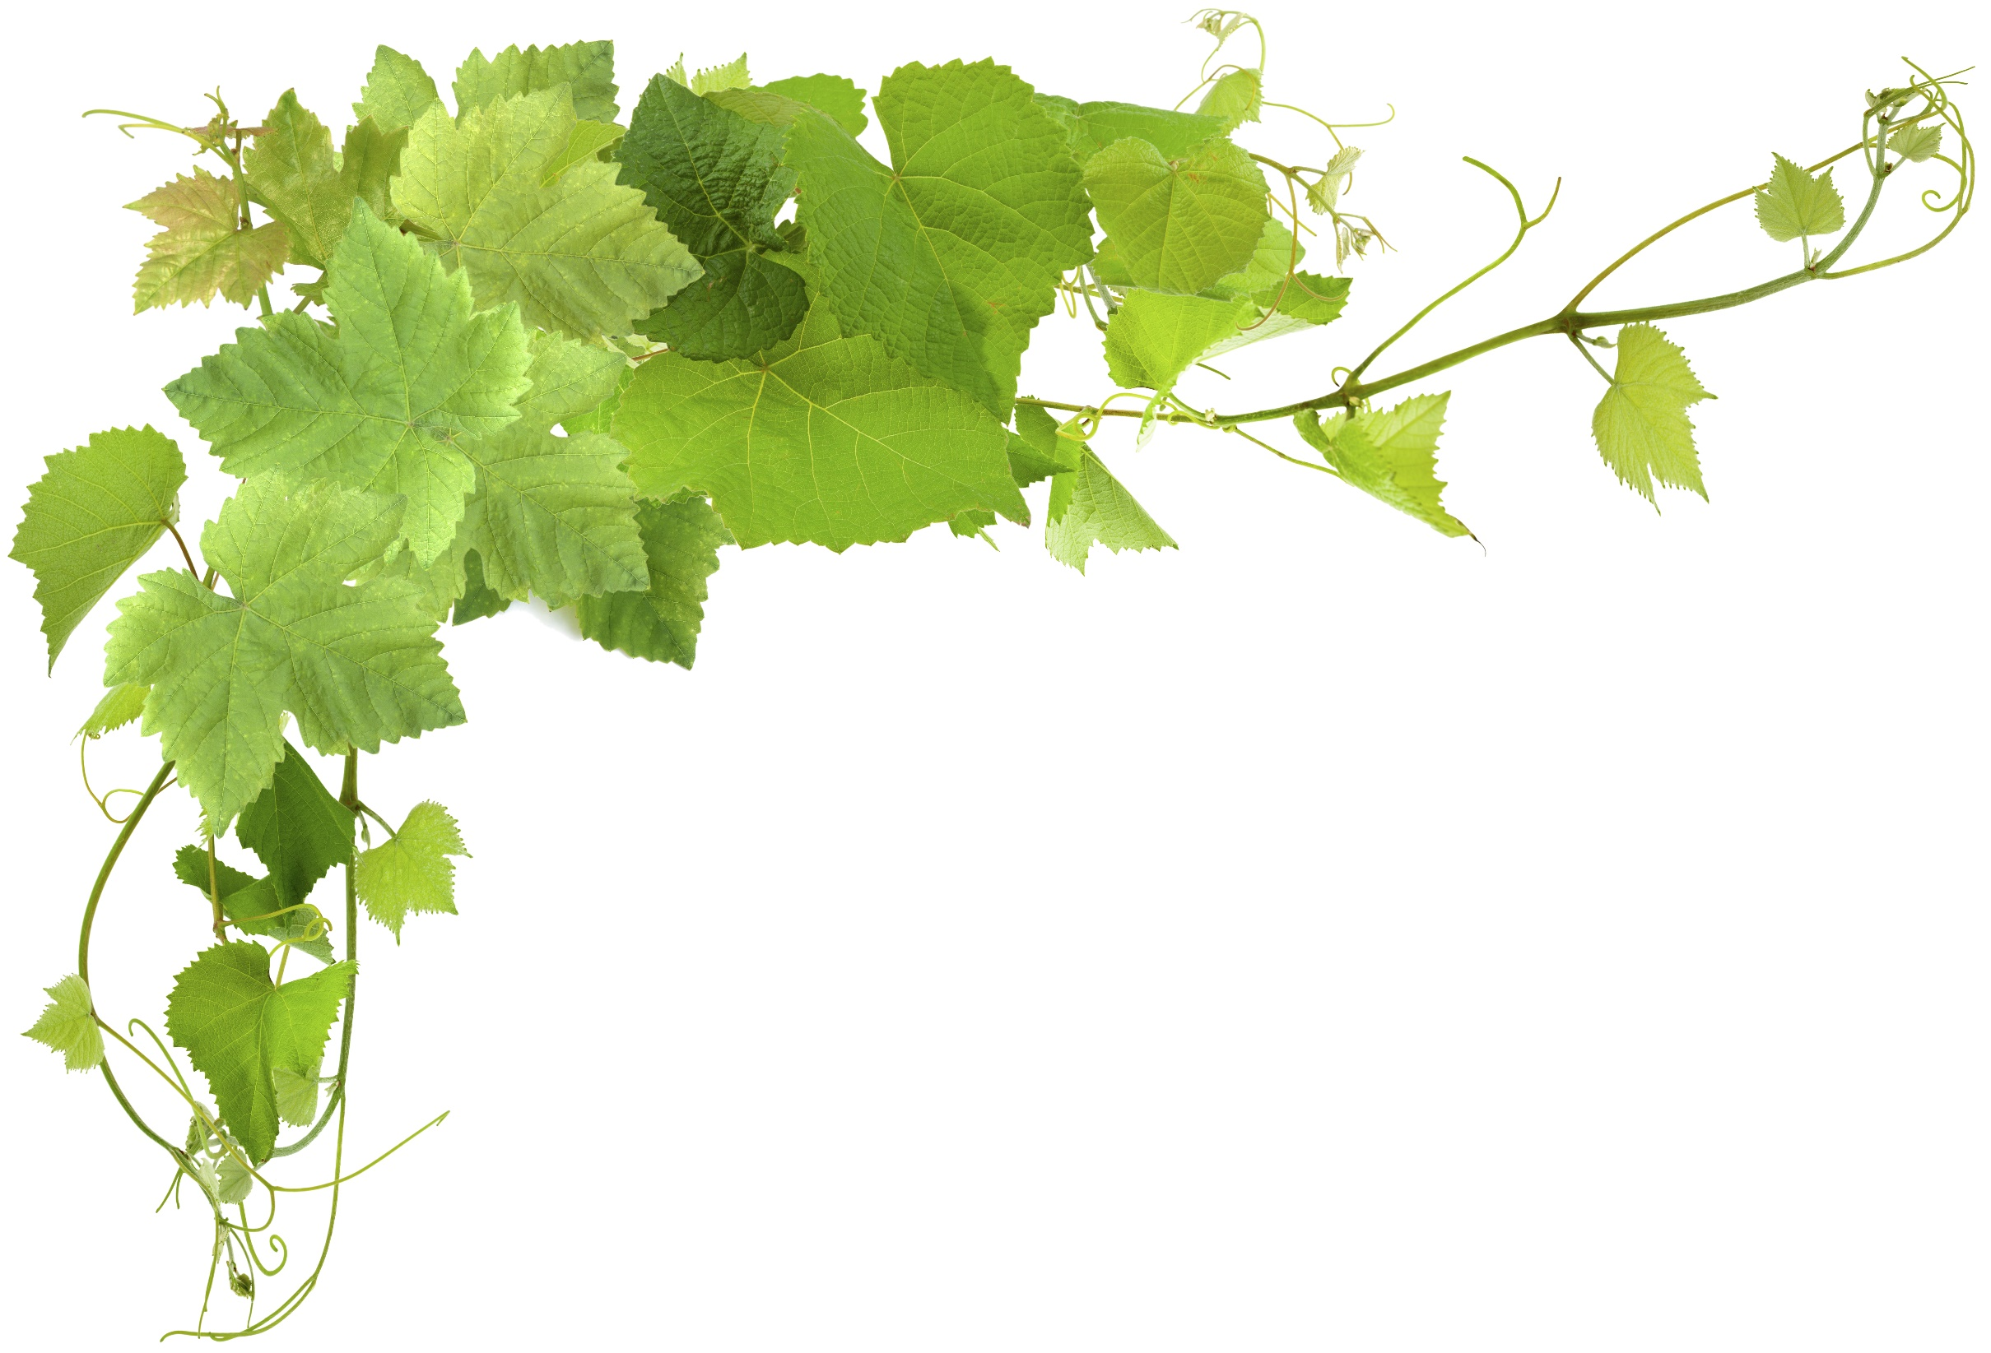
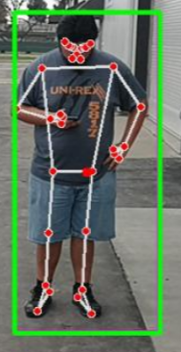

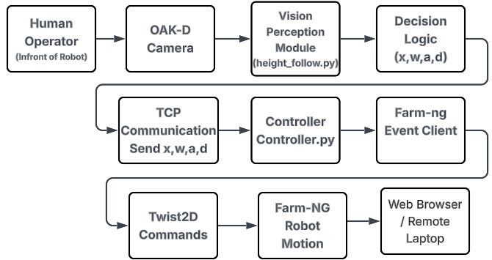
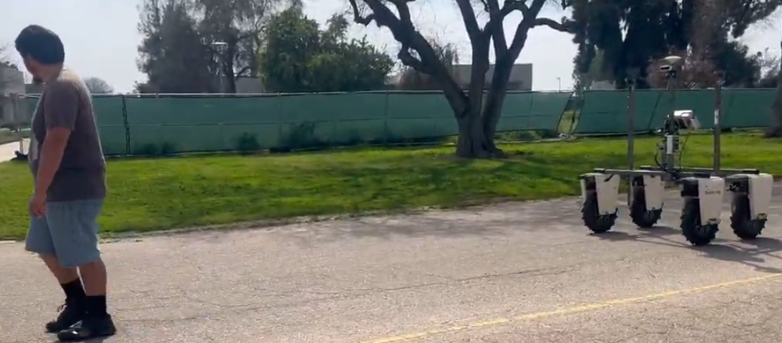


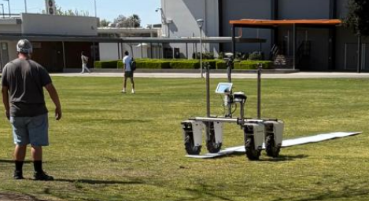
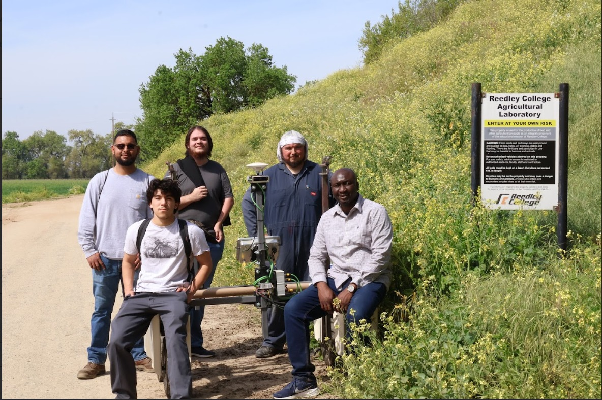
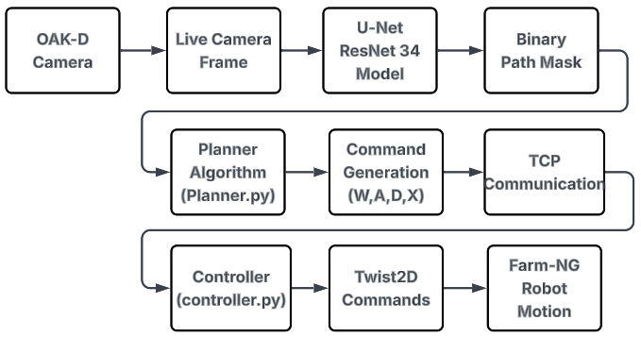


Vision-Based Human and Path Following an Agricultural Robot using Embedded AI and Event-Driven Motion Control
Juan Heredia, Raul Salazar, Bryan Cisneros, Analiz Moreno Gonzalez, Marylynn Moreno, Peter Gutierrez, Allen Vizcarra, Abioye E. Abiodun, Reedley College, 995 N. Reed Ave. Reedley, CA 93654
*lucabrillante@csufresno.edu
Abstract
Human Detection and Tracking Method
Human pose detection is performed using the CVZone Pose Detector, which extracts body landmarks and bounding box information.
Linear velocity (v) control
Distance is approximated using the bounding box height:
$v=$ $\left\{\begin{aligned}0 if h>h_{threshold} \\ vm otherwise \end{aligned}\right.$
Where $v_{max}=0.5m/s$
Angular velocity control
$f\left(x\right)=\left\{\begin{aligned}−x, \left|e\right|<ε \\ xmax e<−ε \\ −ωmax e>ε\end{aligned}\right.$
Where $v_{max}=0.5m\frac{rad}{s}, ε=center of tolerance$
Results
Autonomous human-following robots have significant potential in agricultural operations, enabling intelligent assistance and precision navigation. This paper presents a vision-based human-following system implemented on the Farm-ng Amiga agricultural robot using an embedded OAK camera and real-time pose detection. The system integrates computer vision, event-driven motion control, and network-based communication. Human pose detection is used to generate motion commands based on alignment and proximity thresholds. Experimental results demonstrate reliable tracking, responsive motion control, and stable communication performance. The proposed architecture provides a scalable framework for agricultural robotics and AI-guided navigation.
Fig. 3: Human Detection for Following Navigation Demo
Background
Agricultural automation is increasingly needed to improve efficiency, productivity, and labor support.
Farm workers often need mobile robots to carry tools, transport equipment, and assist in field monitoring.
Current agricultural robots require manual control or complex infrastructure-based navigation systems.
Problem Statement
Reliable human-following in outdoor environments.
In accurate autonomous robot navigation along farm paths and crop rows.
Real-time perception and decision making using low-power embedded systems.
Stable communication between perception modules and robot control.
Fig. 1 Vision-Based Human Following Navigation
Fig. 4: Robot - Human Following Navigation Demo
Path Navigation Method
The model classifies each pixel as either
$\text{Path}=1, \text{Non}\text{ − }\text{Path}=0$
Step 1: Binary Path Mask
The deep learning model outputs a binary image:
$$M(x,y)=\left\{\begin{matrix}1 & \text{drivable} \text{path} \\ 0 & \text{non}\text{−}\text{path}\end{matrix}\right.$$
Objectives
Implement a human-following and path-following system on the Farm-ng Amiga robot.
Use an OAK camera and embedded AI for real-time perception.
Apply pose detection and image segmentation for navigation.
Implement event-driven motion control with TCP communication.
Implement autonomous navigation to allow the robot to operate independently in vineyard rows
Fig. 5: Path Following Navigation Demo
Conclusion
The vision-based system enables autonomous human and path following.
Real-time perception and event-driven control were achieved.
Reliable communication and motion execution worked as designed.
Scalable architecture for agricultural robotics.
Materials & Methods
Amiga robot from Farm-ng was used, featuring autonomous navigation and AI integration capabilities.
OAK Embedded AI Camera
Embedded Processing Unit (Nvidia Jetson)
Fig. 2: Path Following Navigation

